Slide 1
Distributed Database Administration

Slide 2
Distributed Database Administration
Distributed database administration involves managing databases that are distributed across multiple locations or nodes in a network.
Distributed database administration enhance scalability, availability, and performance of database systems.
key aspects of distributed database administration:
Data Distribution
Replication
Data Consistency
Data Security
Performance Monitoring and Optimization
Fault Tolerance and Disaster Recovery
Scalability
Network Management
Compliance and Governance
Backup and Recovery

Slide 3
Data Distribution: Data is distributed across multiple nodes or sites in a network. This distribution can be horizontal (sharding) or vertical (partitioning).
Replication: Replicating data across multiple nodes ensures fault tolerance and availability. Admins need to manage replication strategies, such as master-slave or multi-master replication, to ensure consistency and efficiency.
Data Consistency: Maintaining data consistency across distributed nodes is crucial. Techniques like two-phase commit (2PC) or distributed commit protocols are used to ensure atomicity and consistency of transactions across distributed databases.
Data Security: Admins must ensure data security across distributed databases. This includes encryption, access control, and data integrity mechanisms to protect data both in transit and at rest.
Performance Monitoring and Optimization: Admins monitor the performance of distributed databases and optimize them for efficient data access and processing. This involves tasks like query optimization, load balancing, and resource allocation.

Slide 4
Fault Tolerance and Disaster Recovery: Admins implement strategies for fault tolerance and disaster recovery to ensure the availability and reliability of distributed databases. This includes backup and recovery plans, failover mechanisms, and data replication strategies.
Scalability: Distributed database administrators need to plan for scalability to accommodate growing data volumes and user loads. This involves adding or removing nodes, rebalancing data distribution, and scaling resources as needed.
Network Management: Since distributed databases operate across a network, admins must manage network resources effectively to ensure optimal performance and reliability. This includes monitoring network bandwidth, latency, and security.
Compliance and Governance: Admins must ensure that distributed databases comply with regulatory requirements and organizational policies. This involves implementing data governance frameworks, audit trails, and compliance controls.
Backup and Recovery: Implementing robust backup and recovery mechanisms is essential to safeguard data against accidental deletion, corruption, or hardware failures. Admins must regularly backup distributed databases and test recovery procedures to ensure data integrity and availability.

Slide 5
Distributed Database Administration Tasks
Data Distribution and Replication:
Strategies for Data Distribution
Replication Techniques (Master-Slave, Multi-Master, etc.)
Data Partitioning Methods
Consistency Models (Strong Consistency, Eventual Consistency, etc.)
Data Consistency and Integrity:
Transaction Management in Distributed Environments
Distributed Concurrency Control
Distributed Deadlock Detection and Resolution
Techniques for Maintaining Data Integrity

Slide 6
Distributed Query Processing:
Query Optimization Techniques
Distributed Query Execution Plans
Handling Distributed Joins and Aggregations
Query Routing and Load Balancing
Security and Privacy in Distributed Databases:
Authentication and Authorization Mechanisms
Encryption Techniques for Data in Transit and at Rest
Role-Based Access Control
Auditing and Compliance
Scalability and Performance Optimization:
Horizontal and Vertical Scaling
Replication Strategies for Performance Improvement
Caching and Data Access Optimization
Monitoring and Performance Tuning

Slide 7
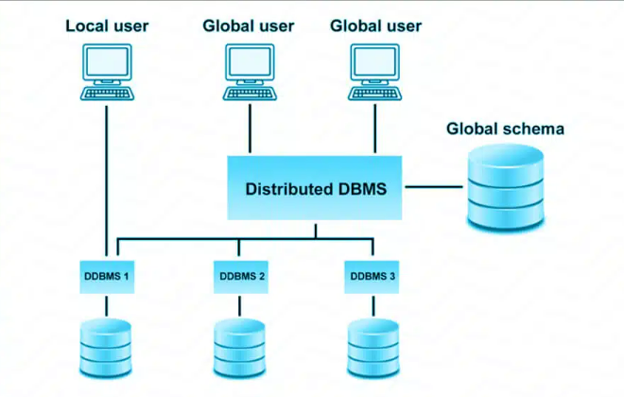

Slide 8
Designing Distributed Databases
The following information is provided to document using Db2 with distributed databases:
Updating a single database in a transaction
Using multiple databases in a single transaction
Updating a database from a host or System i client
Two-phase commit
Error recovery during two-phase commit

Slide 9
Designing Distributed Databases
Updating a single database in a transaction
The simplest form of transaction is to read from and write to only one database within a single unit of work. This type of database access is called a remote unit of work.
Using multiple databases in a single transaction
Updating a database from a host or System i client
Applications executing on host or System i clients can access data residing on Db2 database servers. TCP/IP is the only protocol used for this access.
Two-phase commit
Understanding how a transaction is managed will help you to resolve the problem if an error occurs during the two-phase commit process.
Error recovery during two-phase commit
Recovering from error conditions is a normal task associated with application programming, system administration, database administration, and system operation.
Distributing databases over several remote servers increases the potential for error resulting from network or communications failures.
To ensure data integrity, the database manager provides the two-phase commit process.

Slide 10
Responsibility of the Distributed DBA
Design and plan the replication system, including how and when data is shared among its users.
Only after the distributed DBA has developed a complete design plan can Ingres Replicator be configured successfully.
Coordinate the installation and re-configuration of the system among its different sites.
Monitor and oversee the system at an enterprise level, rather than a local level.

Slide 11
Distributed Database Administration
Site Autonomy
Distributed Database Security
Auditing Database Links
Administration Tools

Slide 12
Site Autonomy
Site autonomy means that each server participating in a distributed database is administered independently from all other databases.
Some of the benefits of site autonomy in an Oracle Database distributed database include:
Nodes of the system can mirror the logical organization of companies or groups that need to maintain independence.
Local administrators control corresponding local data. Therefore, each database administrator's domain of responsibility is smaller and more manageable.
Independent failures are less likely to disrupt other nodes of the distributed database.
No single database failure need halt all distributed operations or be a performance bottleneck.
Administrators can recover from isolated system failures independently from other nodes in the system.
A data dictionary exists for each local database. A global catalog is not necessary to access local data.
Nodes can upgrade software independently.

Slide 13
Distributed Database Security
The database supports all of the security features that are available with a non-distributed database environment for distributed database systems, including:
Password authentication for users and roles
Login packet encryption for client-to-server and server-to-server connections

Slide 14
Auditing Database Links
You must always perform auditing operations locally.
If a user acts in a local database and accesses a remote database through a database link, the local actions are audited in the local database, and
The remote actions are audited in the remote database, provided appropriate audit options are set in the respective databases.

Slide 15
Administration Tools
The database administrator has several choices for tools to use when managing an Oracle Database distributed database system:
Enterprise Manager
Third-Party Administration Tools
SNMP Support

Slide 16
Enterprise Manager
Enterprise Manager is the Oracle Database administration tool that provides a graphical user interface (GUI).
Enterprise Manager provides administrative functionality for distributed databases through an easy-to-use interface.
You can use Enterprise Manager to:
Administer multiple databases.
Centralize database administration tasks.
Manage security features such as
global users,
global roles, and
the enterprise directory service.
Dynamically execute SQL, PL/SQL, and Enterprise Manager commands.
Can be use Enterprise Manager to enter, edit, and execute statements.
Enterprise Manager also maintains a history of statements executed.

Slide 17
Third-Party Administration Tools
Currently more than 60 companies produce more than 150 products that help manage Oracle Databases and networks, providing a truly open environment.
SNMP Support
Besides its network administration capabilities, Oracle Simple Network Management Protocol (SNMP) support allows an Oracle Database server to be located and queried by any SNMP-based network management system.
SNMP is the accepted standard underlying many popular network management systems such as:
HP OpenView
Digital POLYCENTER Manager on NetView
IBM NetView/6000
Novell NetWare Management System
SunSoft SunNet Manager

